Slide 1
Campaign Overview

Slide 2




Marketing 101
$1.7 trillion
The science and art of exploring, creating, and delivering value to satisfy the needs of a target market at a profit.
- Philip Kotler
85%
38%
2.8X
Global Spend on Marketing Media
of
India’s Annual GDP
of
Global Medical Expenditure
of
US Military Expenditure

Slide 3

Why Marketing?
Marketing Campaigns is used to establish or change the brand positioning of the company
Brand Positioning
Creating awareness
Create awareness about products, new offers, location launches
Acquire Customers
Reward Customers
Communicate with customers at a mass level to generate interest and give incentive to shop
Reward and retain existing customers for engaging with the brand

Slide 4
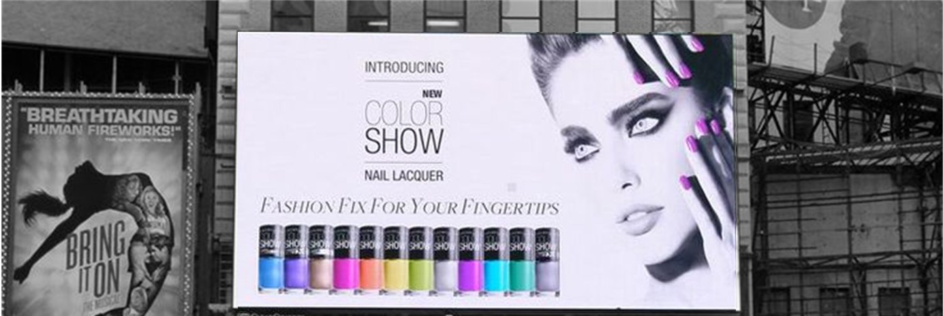





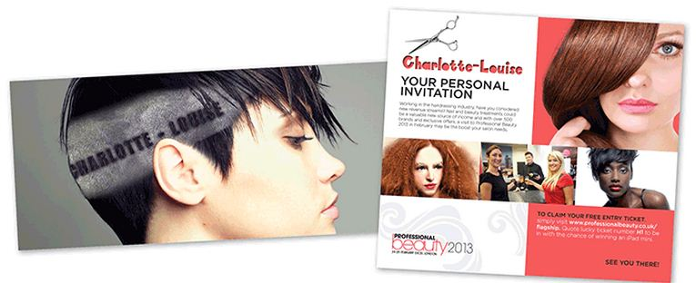

Types of Campaigns
Above the
Line
Television
Billboards
Internet
Reaching to a Broader Audience
Establish Brand Positioning
Raising Customer Awareness
Acquiring new customers
Radio
Magazines
Through the Line
Direct Mail
Belowthe
Line
Door to Door
Reaching to a Targeted Audience
One to one messaging
Raising Customer Awareness
Rewarding customers
E-Mail
Exterior Location Based

Slide 5
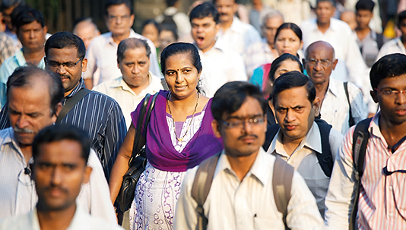
Exercise 1
Group 1
Design a campaign to sell a Smartphone
Group 2
Design a campaign to sell
Life Insurance
Group 3
Design a campaign to sell a
Personal Loan

Slide 6

delight is born from real connect
communication
creative
relevant

Slide 7
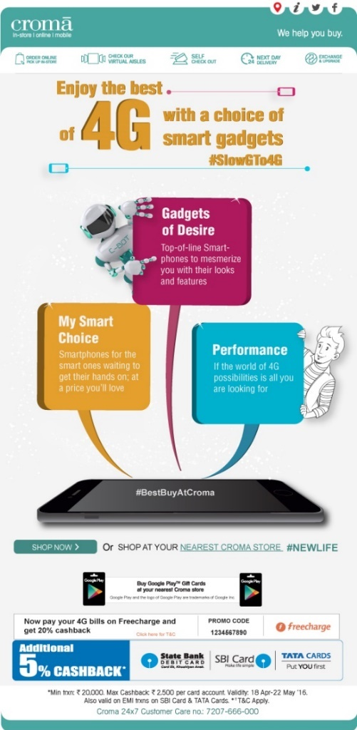
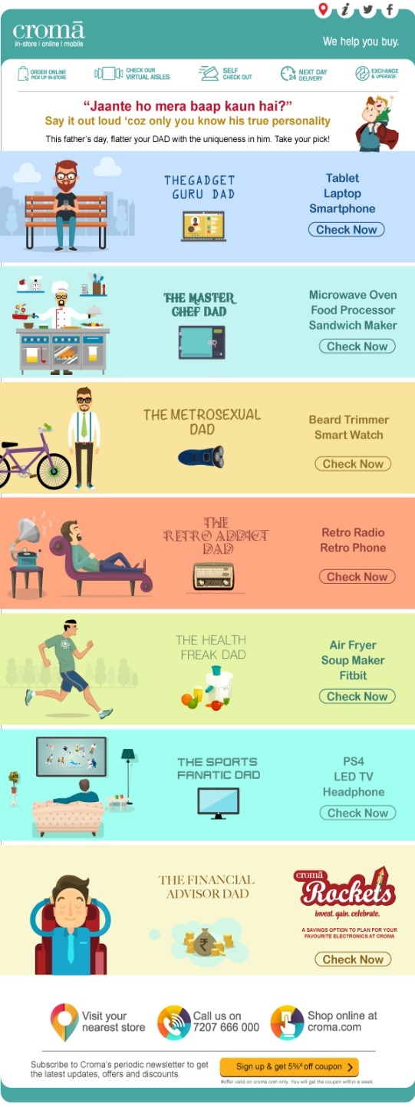
Product based Campaign Creatives
Engaging customers in festivities

Slide 8
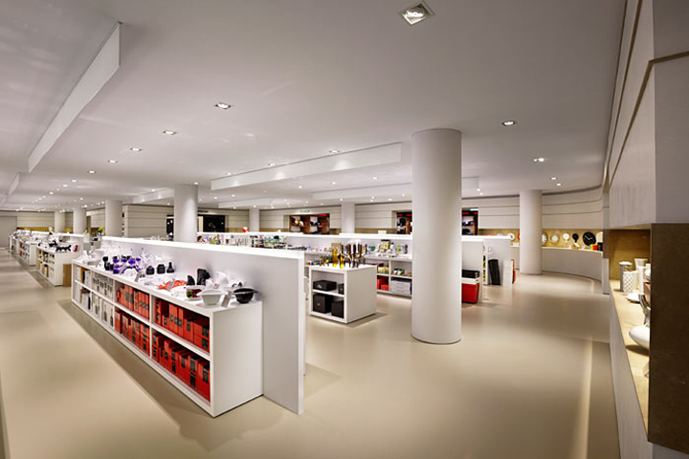
BTL Campaigns
Campaign Design
Campaign Design is the structure of the campaign defining the objective of the campaign, how the campaign will be executed, and designing the creatives aligned to the message it needs to impart

Slide 9
BTL Campaigns
Campaign Design
Relevancy is an important part of offer design where the right audience is given the right offer. This is the fundamental step towards personalization
Relevant Offers

Slide 10
BTL Campaigns
Campaign Design
Defining the Target Group based on historical behaviour and/or profiling is important to ensure the campaign is sent to the right number of targets and the right group of customers
Relevant Offers
Target Group

Slide 11
BTL Campaigns
Campaign Design
A successful campaign must have effective positive customer impact, which in turn would lead to business impact. Being relevant to customers with the right offers and communicating using the right message is crucial for customer impact
Relevant Offers
Customer
Impact
Target Group

Slide 12
Exercise 2

Slide 13
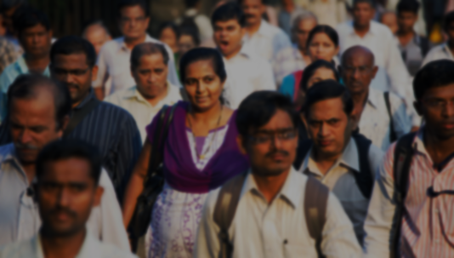
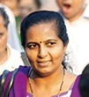
Exercise 2
Mrs. Sharma is a working mother of two young daughters. One of them has just started working, and other is still pursuing her studies.
The younger daughter is very updated with newest trends and influences her mother’s decisions on buying ‘technical’ items.

Slide 14

Exercise 2
Mr. Gaekwad works in the accounts department. His only son is studying to be a doctor. His wife is a homemaker and is very fond of cooking. Mrs. Gaekwad has the last word on shopping.

Slide 15





Campaigns – Connecting with the customer
The Lifecycle of a customer, and how she engages with an institution is dependent on how the institutions interact with her
Engage
Loyalty
Advocacy
Engagement
Awareness| Reward
Awareness
Celebrate
Customer Engagement Life-Cycle
Reward | Retain | Refer
Grow
Awareness | Reward | Stretch
Retain
Reward | Retain

Slide 16
Thank you

